Slide 1
Practical
Focus/Domination Game

Slide 2
What You Need to Do in this LAB
Download the CLion project provided in Week 8 >> Practical March 27 >> Focus.zip
Import the project in CLion and familiarize with the code
TO UNDERSTAND THE CODE YOU WILL NEED TO READ THE REST of the slides AND the COMMENTS PROVIDED IN THE SOURCE FILES
Implement the data structure necessary to define the players in game_init.h
Players should be characterized by: name, color, number of own pieces accumulated, number of adversary’s pieces captured.
Implement method initialize_players
Implement a new method to visualize the size of the stacks in each square of the board.
Between 12 and 1pm you should fill the QUIZ in Week 8 >> Practical March 27. This will be used to take note of your attendance.
Notes:
2

Slide 3
Contents of the Focus Project (1/2)
The project includes the following files:
main.c: declares the variables representing the players and the board. It invokes the functionalities to initialize the players and the board.
game_init.h: it provides constants to represent the color of the pieces (GREEN/RED) and the type of squares (VALID/INVALID). It also provides the data structures to represent players, pieces and the squares of the board. Finally, it includes the prototypes of the methods necessary to create the players and the board.
game_init.c: it implements the methods necessary to create the players and the board.
Notes:
3

Slide 4
Contents of the Focus Project (2/2)
input_output.h: It is the library that contains the methods to print on the standard output and require inputs from the users. At the moment, it only includes a method to print the board. You can add more method prototypes to ask the users’ inputs during the game.
input_output.c: It implements the methods declared in input_output.h. At the moment, it only implements the method necessary to print the board.
Notes:
4

Slide 5
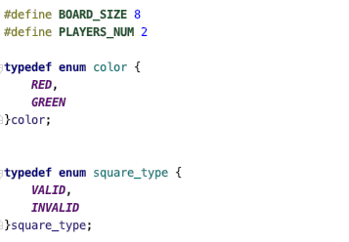
game_init.h
Defines basic constants and pre-defined values
The size of the board (8x8)
The number of players (2)
The color of the pieces (e.g., RED or GREEN)
A square of the board can be
INVALID: squares that are on the sides and where no piece can be placed
VALID: squares where it is possible to place a piece or a stack
Notes:
5

Slide 6
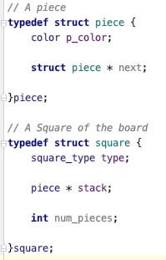
game_init.h
It also defines the data structures necessary to represent players, the squares of the board and the pieces composing stacks.
A piece is characterized by a color and a pointer to the next piece on the stack
For this lab you do not have to worry too much about the next pointer.
Notes:
6

Slide 7
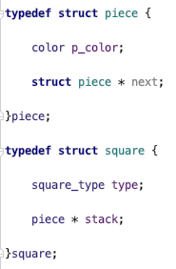
game_init.h
It also defines the data structures necessary to represent players, the squares of the board and the pieces composing stacks.
A square is characterized by:
a type (VALID/INVALID);
a pointer to the piece on top of the stack;
the number of pieces that are stacked on the square
Notes:
7

Slide 8
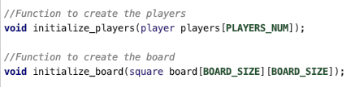
game_init.h
It also declares the prototype of the methods necessary to initialize the players and the board.
This is the prototype of the function that creates the players for the first time. It takes as input an array of two players
You will have to implement this function inside game_init.c
Notes:
8

Slide 9
game_init.h
It also declares the prototype of the methods necessary to initialize the players and the board.
This is the prototype of the function that creates the board for the first time. This function is implemented inside game_init.c
It takes as input a 2-Dimensional (8x8) array of squares representing the board to be initialized.
Notes:
9

Slide 10
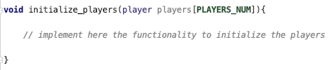
game_init.c
Contains the implementation of the function necessary to initialize the board and the players.
In this LAB, you will have to implement the following function necessary to initialize the players.
This function receives as input an array of players that you should fill with the information about the players that the users provide as input.
Notes:
10

Slide 11
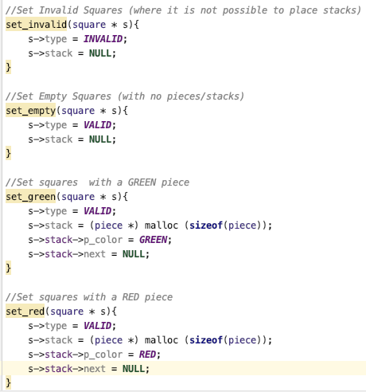
game_init.c
Contains the implementation of axuliary functions necessary to initialize the board.
Notes:
11

Slide 12
game_init.c
Sets invalid squares where no pieces can be placed
Sets valid squares with no pieces
Sets valid squares with GREEN pieces
Sets valid squares with RED pieces
Notes:
12

Slide 13
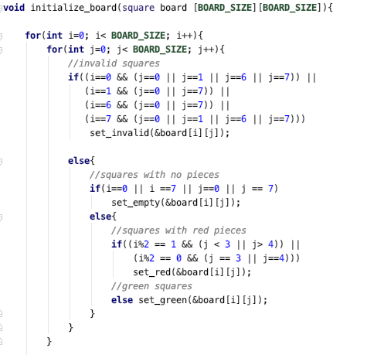
game_init.c
Contains the implementation of the method necessary to initialize the board.
Notes:
13

Slide 14
game_init.c
Contains the implementation of the method necessary to initialize the board.
Sets invalid squares
(0,0), (0,1), (1,0), (0,7), (0,6), (1,7), (7,0). (6,0), (7,1), (7,7), (7,6), (6,7)
Notes:
14

Slide 15
game_init.c
Contains the implementation of the method necessary to initialize the board.
Sets empty squares and those that have RED and GREEN pieces.
Notes:
15

Slide 16

input_output.h
This header file contains the prototypes of the methods to print on the standard output and to require input from the user.
At the moment it only contains the prototype of the method necessary to print the board
Notes:
16

Slide 17
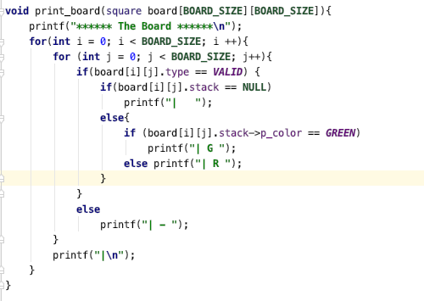
input_output.c
This source file contains the implementation of the methods declared in input_output.h.
Notes:
17

Slide 18
input_output.c
This source file contains the implementation of the methods declared in input_output.h.
Valid empty squares are printed as | |
Notes:
18

Slide 19
input_output.c
This source file contains the implementation of the methods declared in input_output.h.
Valid squares with a GREEN piece are printed as | G |
Notes:
19

Slide 20
input_output.c
This source file contains the implementation of the methods declared in input_output.h.
Valid squares with a RED piece are printed as | R |
Notes:
20

Slide 21
input_output.c
This source file contains the implementation of the methods declared in input_output.h.
Invalid Squares are printed as | - |
Notes:
21

Slide 22
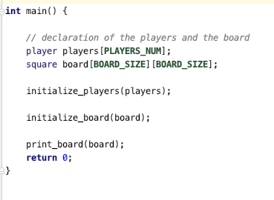
main.c
Notes:
22

Slide 23
main.c
Declares the main entities of the game: the board, the players and the number of players.
Notes:
23

Slide 24
main.c
Initializes the players and the board and prints the board.
Notes:
24

Slide 25
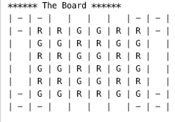
Output
The program prints the board of the game as follows
Notes:
25

